Slide 1
Visualizing MIMIC-III Data
Jaykumar Patel

Slide 2
Introduction
The MIMIC-III dataset provides a comprehensive view of hospital patient records.
I introduce new visualizations regarding patient, transfer, prescription, lab, and procedures data.
These visualizations provide a deeper understanding of trends that can aid in healthcare analysis.
Note: All plots are from the Matplotlib Library unless otherwise specified. Other libraries used include Plotly, Bokeh, Altair, and WordCloud

Slide 3
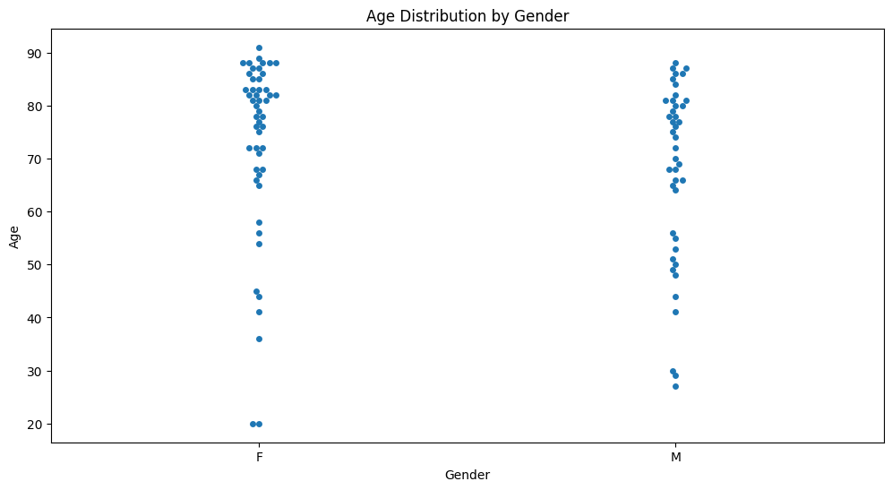
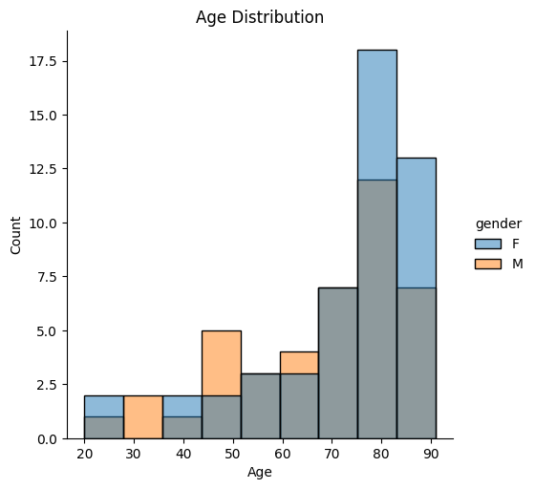
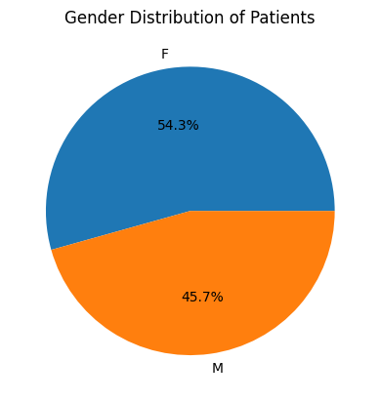
Patient Data
The swarmplot (top) and the distplot (bottom left) show the age range of the patients in the dataset.
The pie chart (bottom right) shows the gender distribution of the patients in the dataset.
These plots can help us determine variations in age and gender of patients.

Slide 4
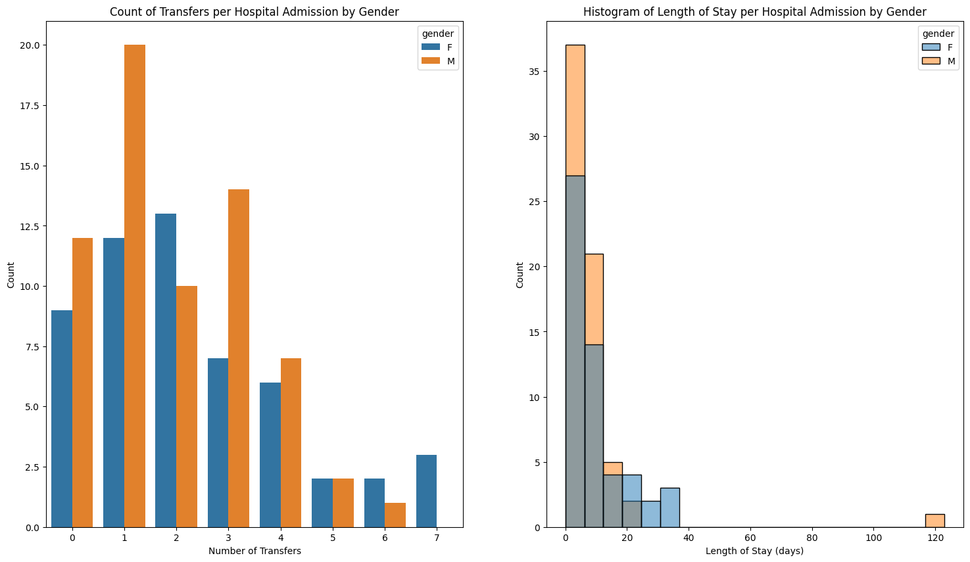
Transfers Data
Here, we uncover the distributions of number of transfers using a countplot (left) and length of stay (right) by gender using a histplot.
This reveals how often patients are expected to transfer and how long they are expected to stay – both split by gender.

Slide 5
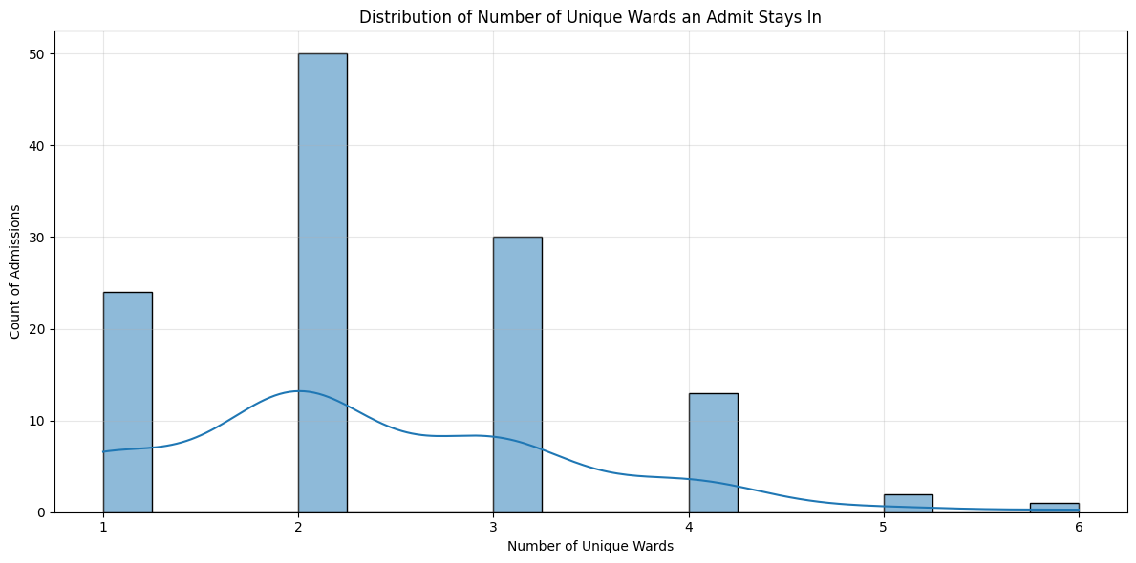
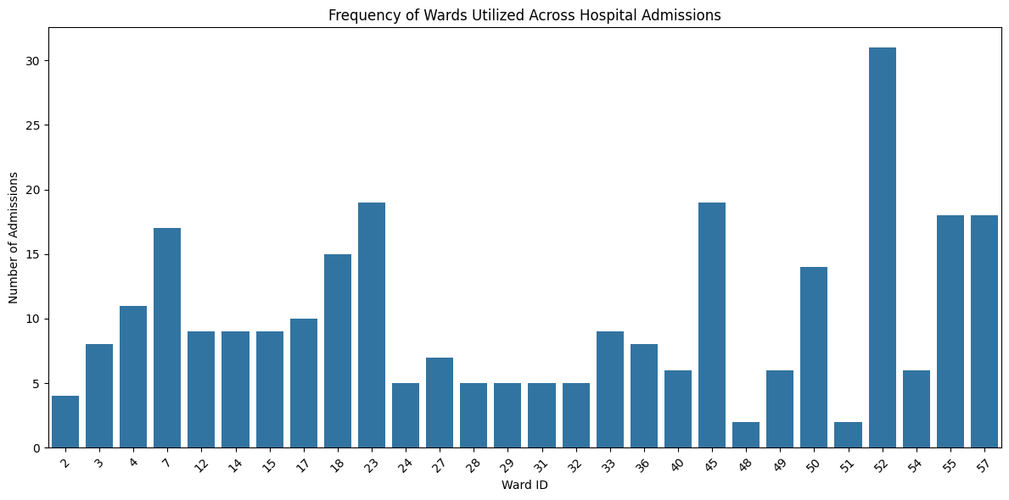
Transfers Data
We continue by visualizing ward data.
We discover the distribution of number of unique wards a patient stays it during an admission (top) using a histplot.
Additionally, we can also see which wards tend to see the most traffic – which wards are most expected to be utilized during an admission (bottom) – using a barplot.

Slide 6
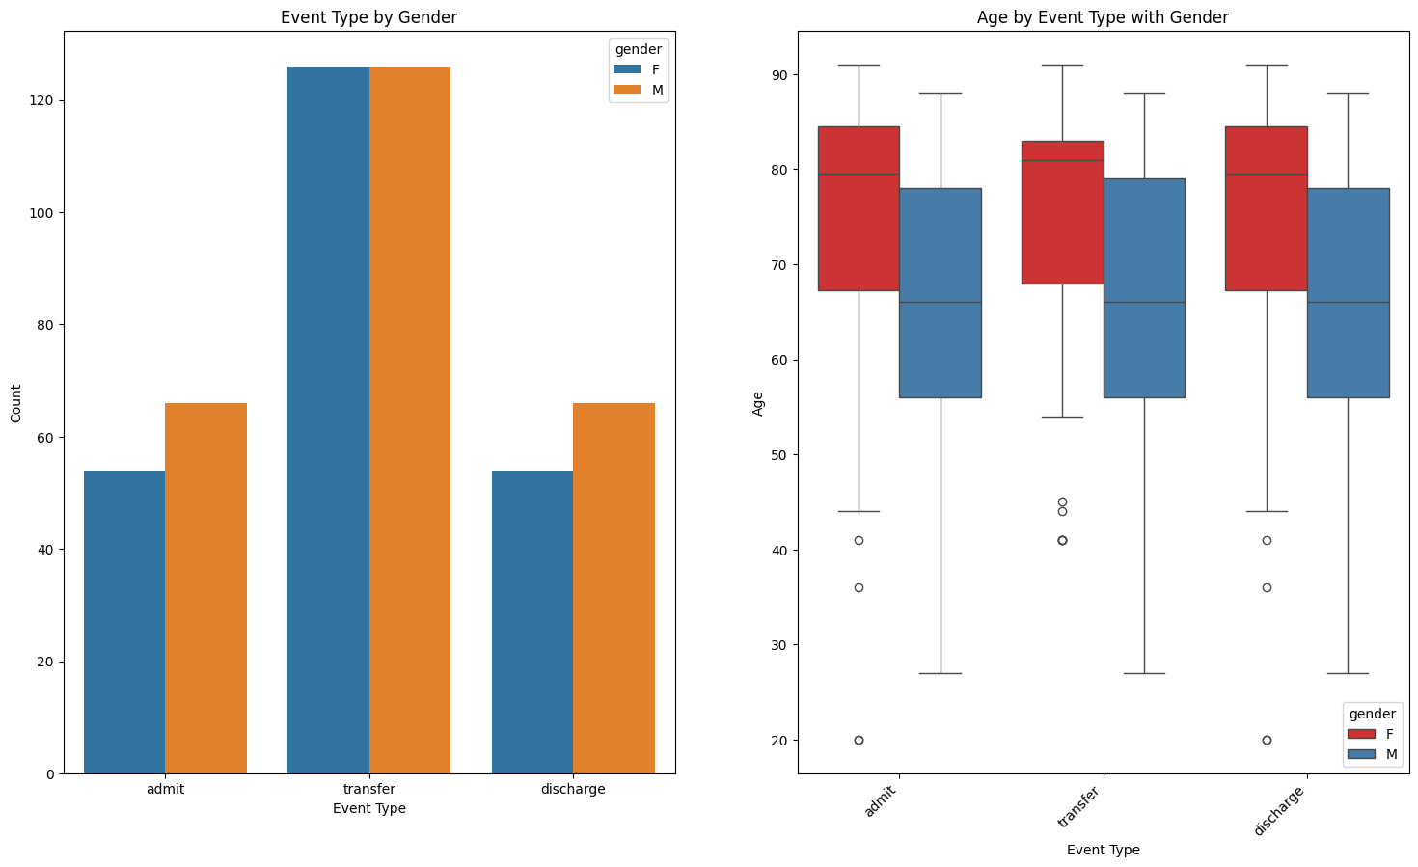
Transfers Data
We continue by exploring the count of types of events per gender (left) using a countplot – which seems to be very similar between male and female.
Additionally, the boxplot (right) enables to see the age distribution of patients for each event type. Data shows that females tend to have more outliers than males.

Slide 7
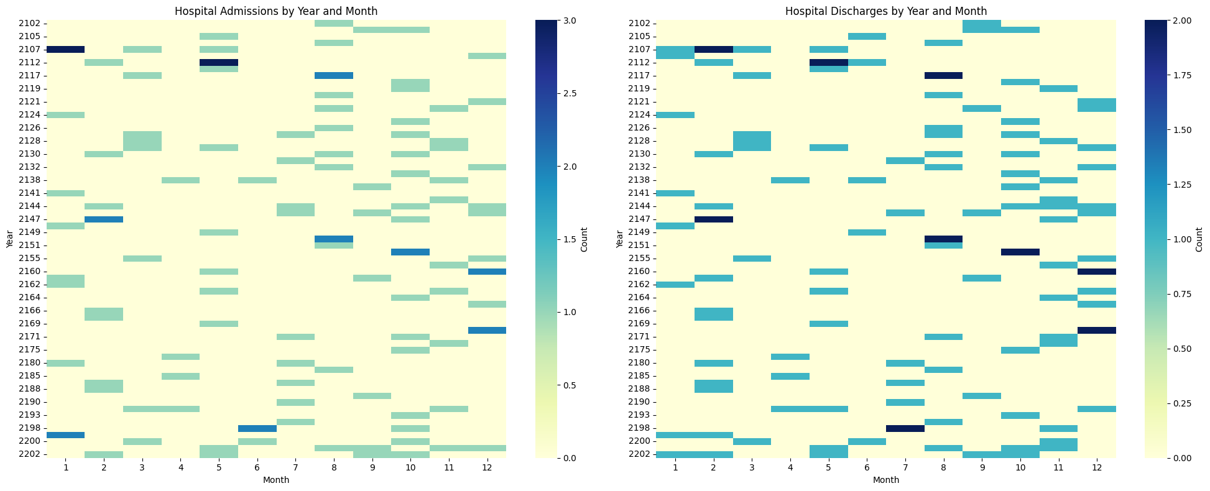
Transfers Data
We also visualize the number of admissions (top) and discharges (bottom) for a given year and month using heatmaps.
This can not only help us determine if certains months and years has spikes in admissions, but can also help analyze lengths of stays that last longer than a month.

Slide 8
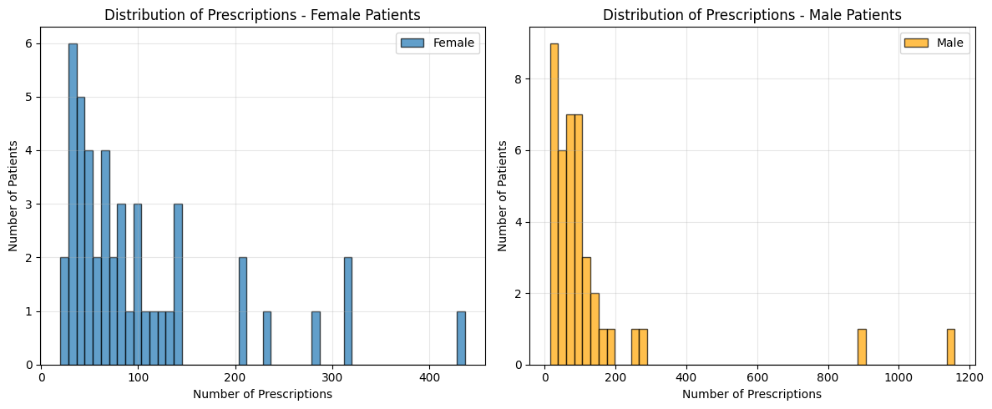
Prescriptions Data
We delve into uncovering insights about prescriptions data.
We start by visualizing the distribution of number of prescriptions for females (top) and males (bottom) using histograms.
We can uncover patterns such as which gender is likely to receive more prescriptions as well as the expected number of prescriptions.

Slide 9
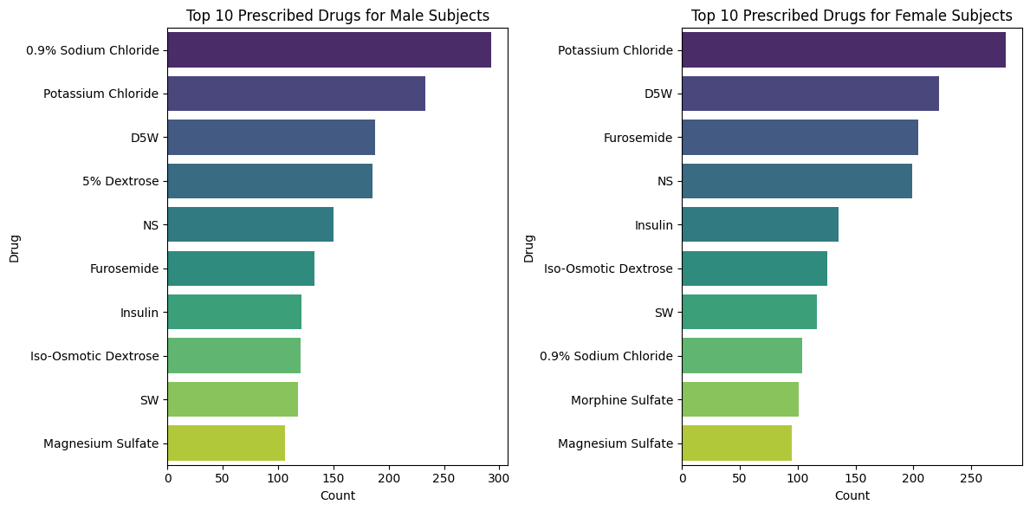
Prescriptions Data
These barplots help us understand the top 10 prescriptions for males (left) and females (right).
Understanding which drugs are most commonly prescribed can help insinuate which diagnoses or symptoms are common.

Slide 10
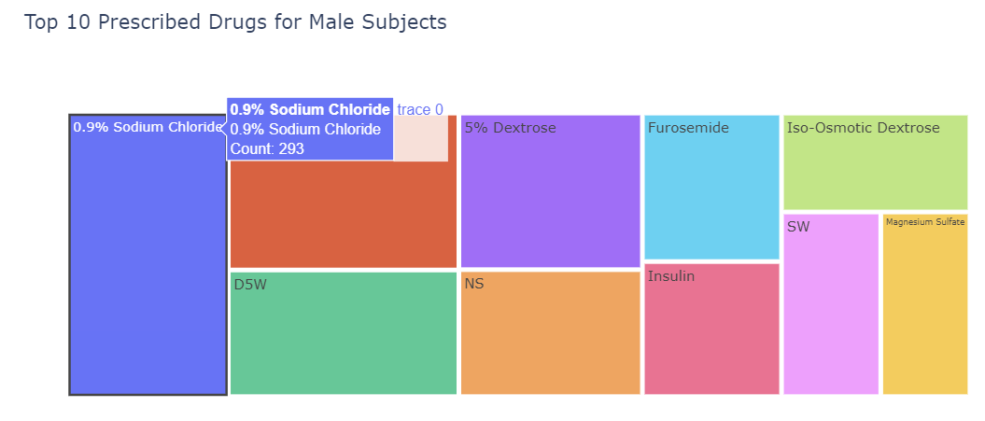
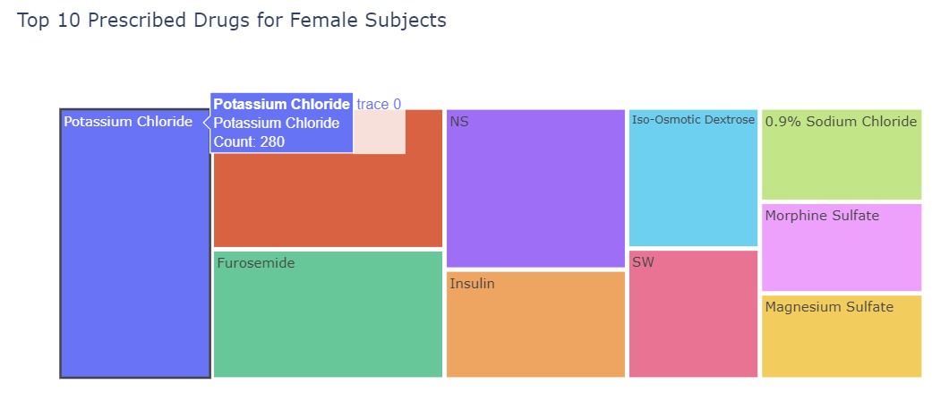
Prescriptions Data
Previous slide’s data can also be visualized differently using an interactive Treemap from the Plotly library.
Hovering on each cell uncovers data such as the number of times that drug was prescribed.

Slide 11
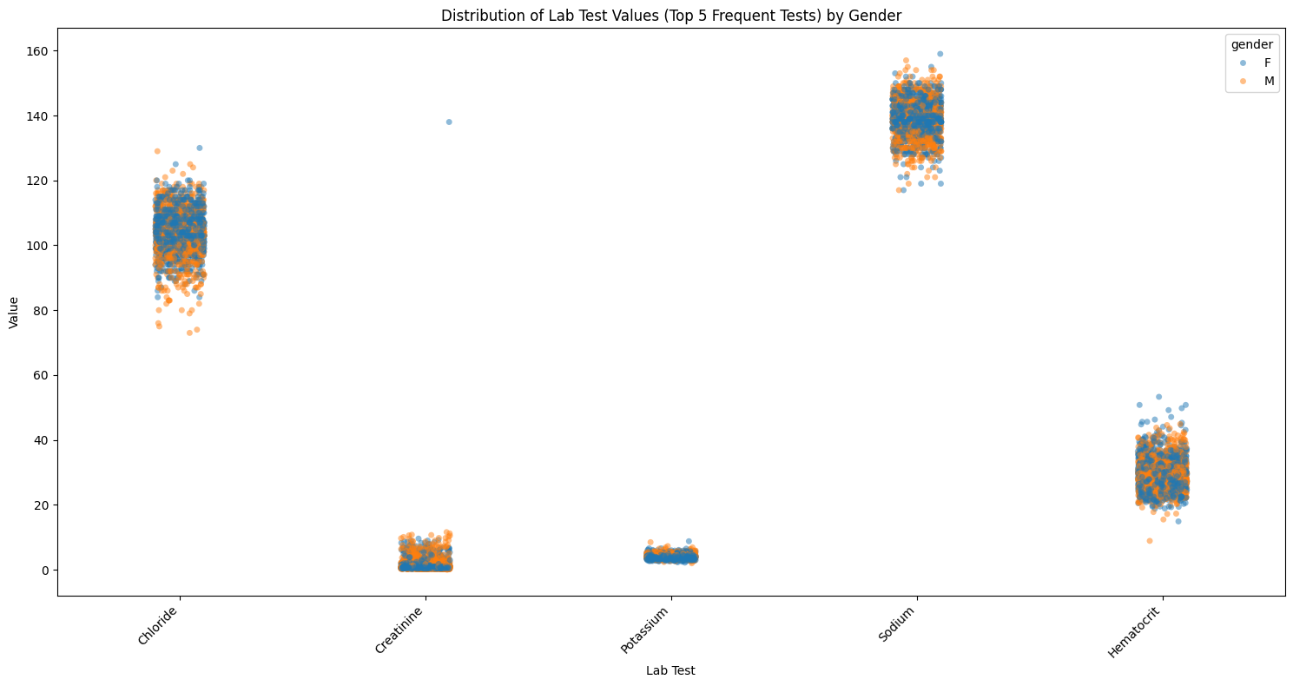
Lab Data
Next, we visualize Lab data to discover patterns and trends in lab tests.
In the stripplot to the right, we can see the distribution of lab test values for the 5 most common tests – split by gender.
This can help determine which tests and gender typically sees a larger spread and more outliers.

Slide 12
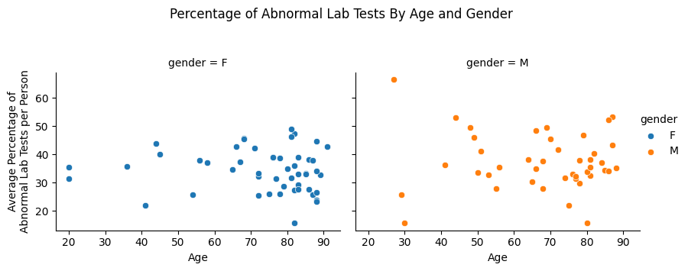
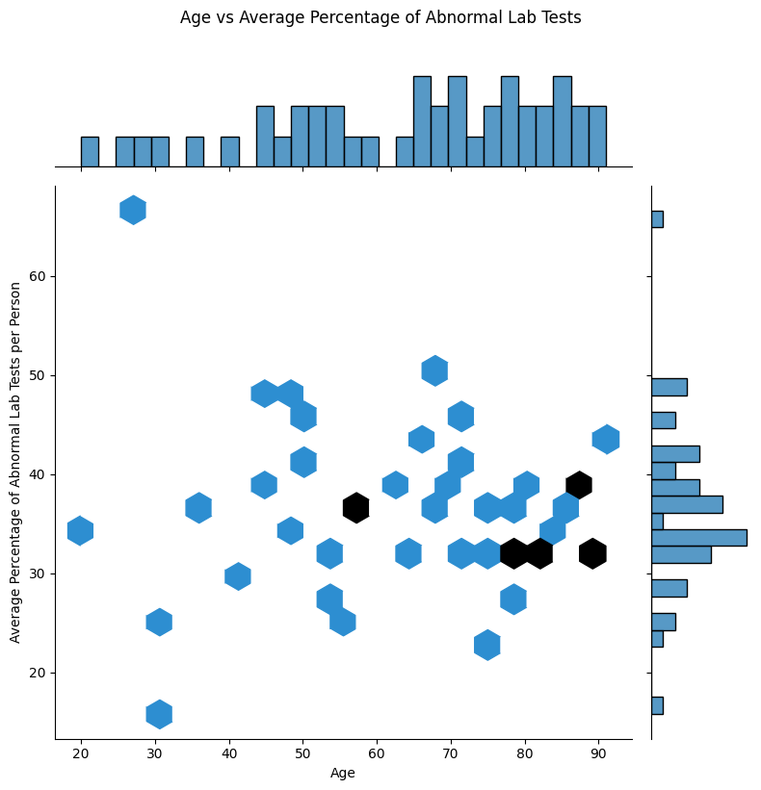
Lab Data
Plotting the scatterplot of average percentage of abnormal tests per person vs age can help uncover trends regarding age-related health patterns.
The jointplot (bottom) helps us visualize this data.
The scatterplots (top) split the data by gender, adding it as a factor alongside age.

Slide 13
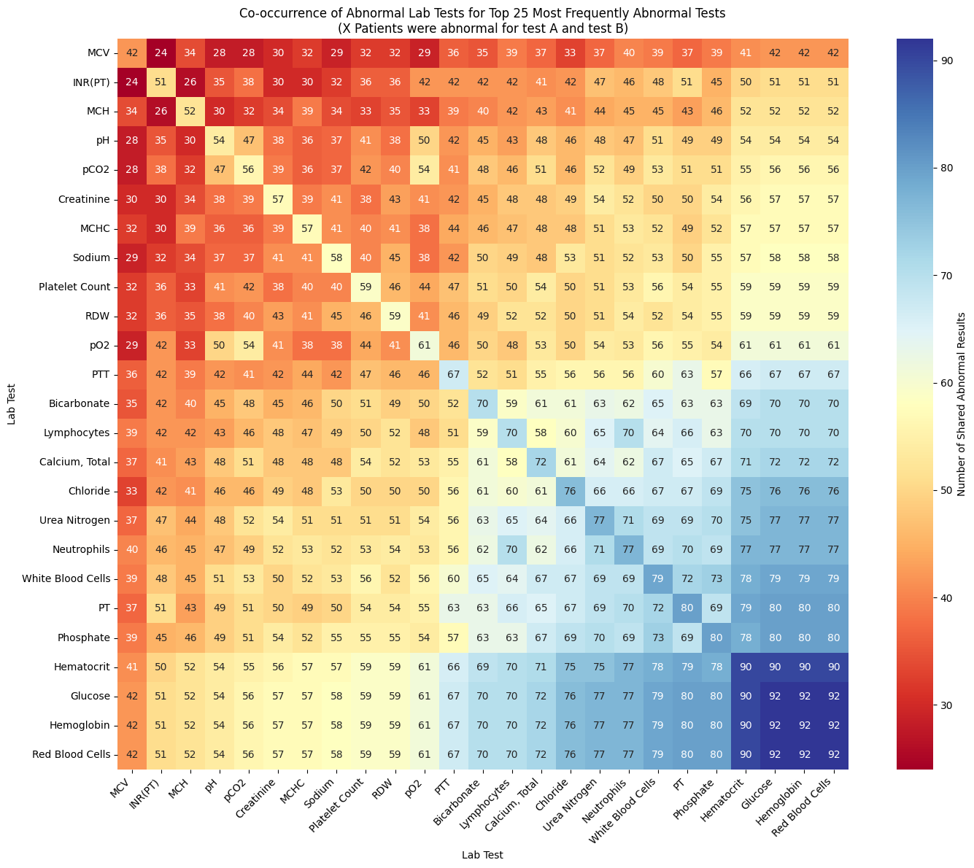
Lab Data
Plotting the co-occurence of abnormal tests as a heatmap can help highlight which tests are correlated with each other.
This can help predict which tests will be abnormal given that certain others were abnormal.
This can help speed up diagnosis and potentially prevent unnecessary tests.

Slide 14
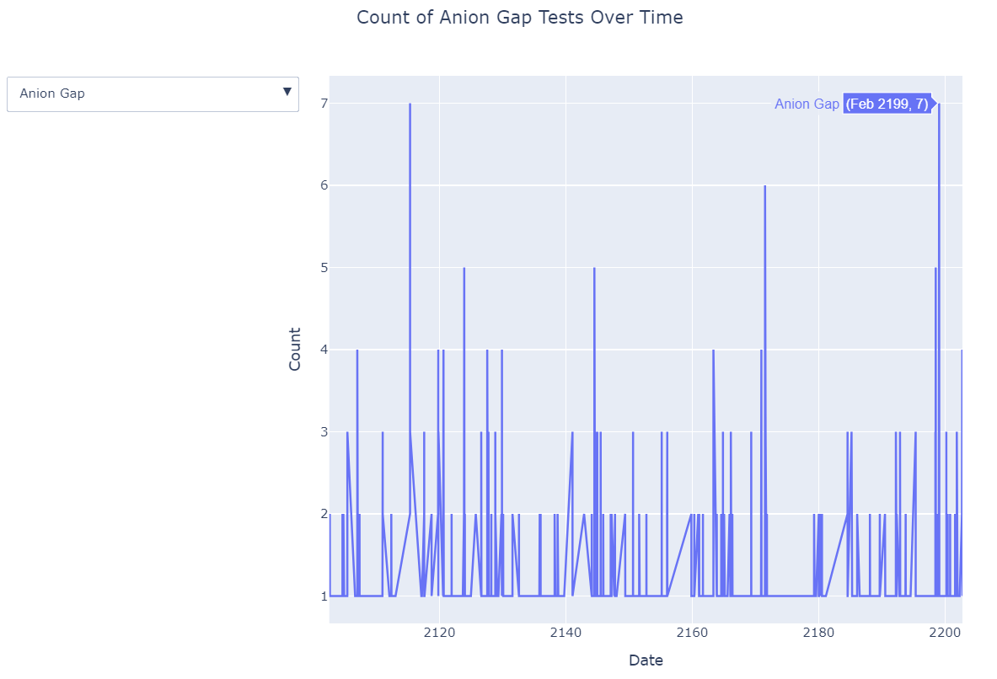
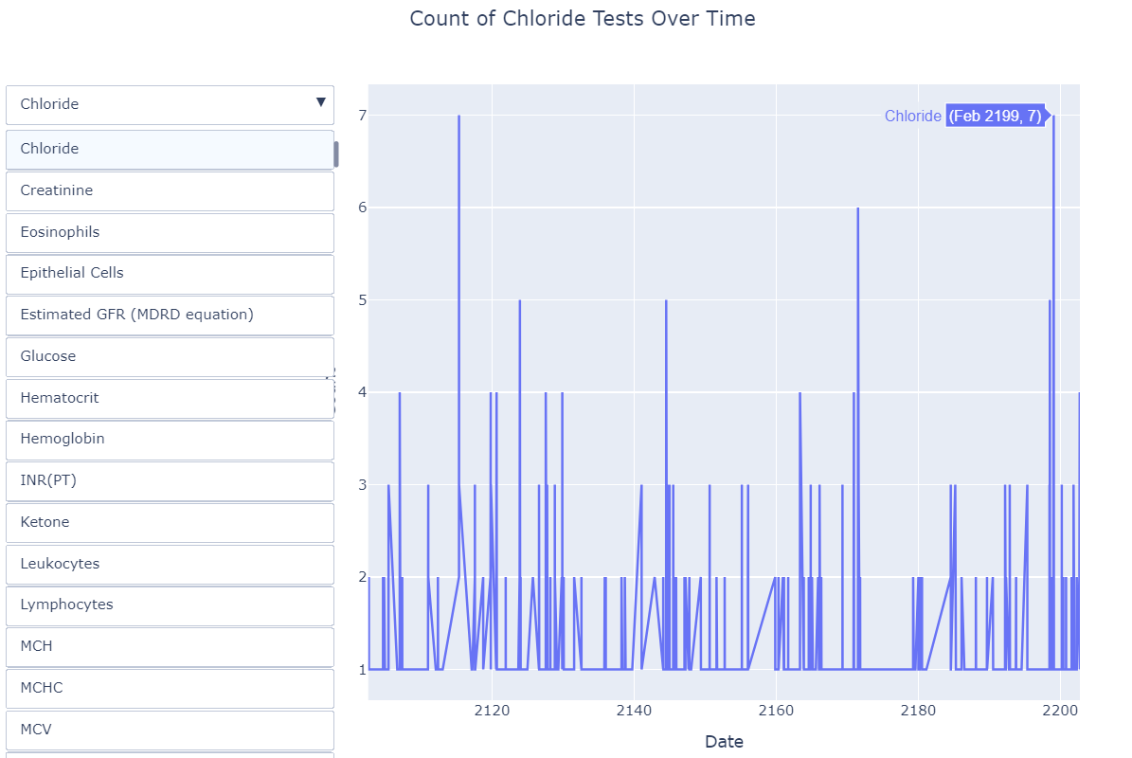
Lab Data
Using Plotly, I create an interactive scatter plot (with connected lines) to visualize the number of tests completed over time.
Hovering on a point shows the exact count of the test for that Month, Year.
This can help highlight trends over time, and potentially help predict what tests will be “in demand” for a certain time period.
This can help manage supply and demand.

Slide 15
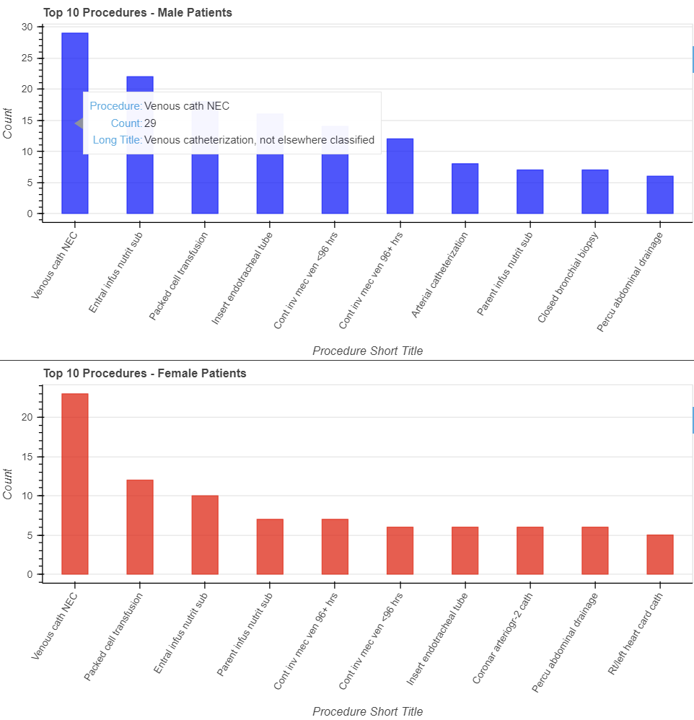
Procedures Data
Using Bokeh, I created an interactive bar chart that visualizes the count of the top 10 procedures split by gender.
Hovering over the bars displays the procedure name, count, and long title.
This data unveils which procedures are the most popular and can show gender-specific trends.

Slide 16
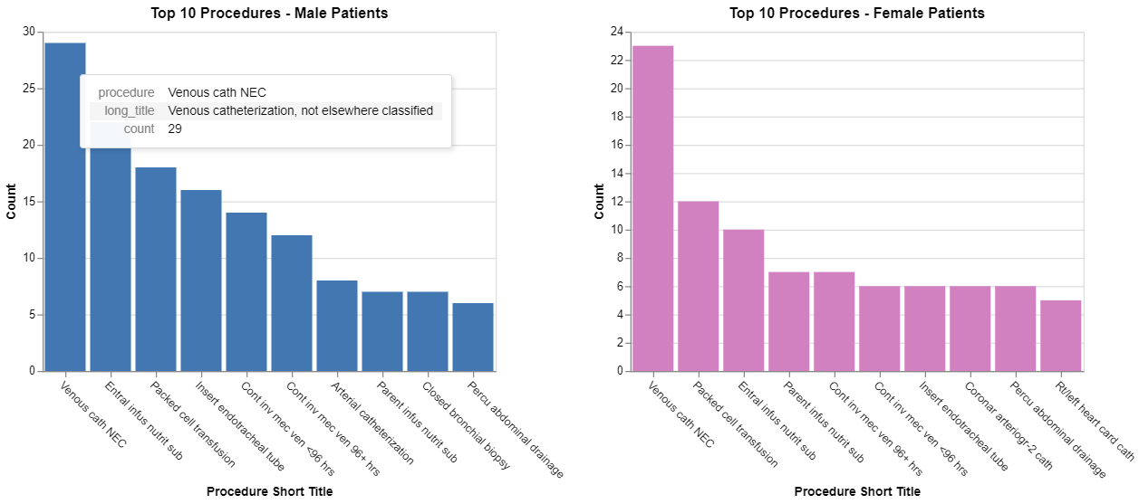
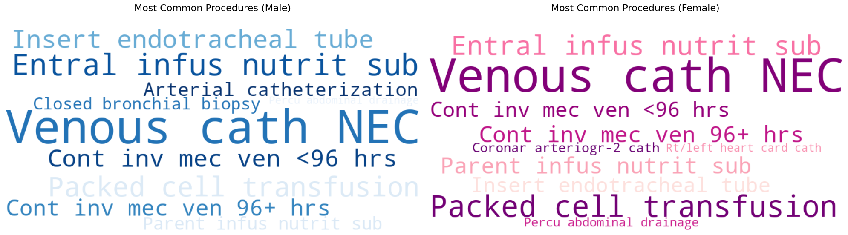
Procedures Data
Previous slide’s data can also be visualized differently using an interactive bar chart from the Altair library (top) and a word cloud from the WordCloud library (bottom).
Hovering over the bars on the bar chart displays the procedure name, count, and long title.
The word cloud may not provide exact counts, but it easily highlights the most common procedures by gender.
Note: Previous slide and this slide demonstrate different ways (and libraries) to visualize the same data in interactive and innovative methods.

Slide 17
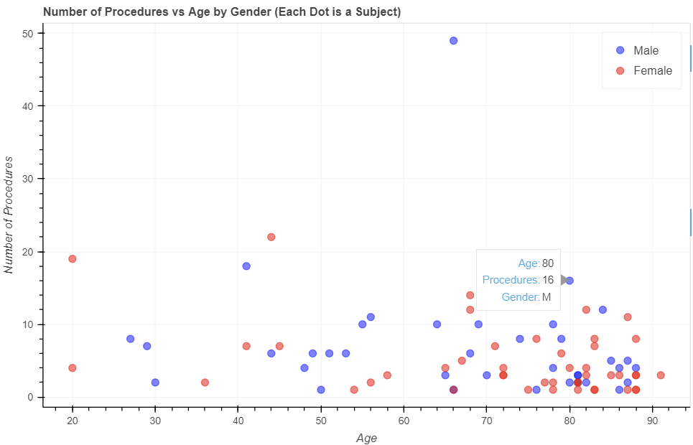
Procedures Data
Finally, using Bokeh, I create an interactive scatter plot that shows the cumulative number of procedures for each age group split by gender.
Hovering over a cell displays the age, count of procedures, and the gender.
This data can be used to analyze age-specific and gender-specific procedures trends.

Slide 18
Conclusion
The visualizations demonstrate the complex and interconnected nature of the MIIMIC-III dataset.
Using various Python libraries (Matplotlib, Seaborn, Plotly, Bokeh, Altair, and WordCloud), we can extract insightful information that can be used by healthcare professionals to
Identify trends
Improve decision-making
Develop predictive models

Slide 19
Conclusion
The visualizations demonstrate the complex and interconnected nature of the MIIMIC-III dataset.
Using various Python libraries (Matplotlib, Seaborn, Plotly, Bokeh, Altair, and WordCloud), we can extract insightful information that can be used by healthcare professionals to
Identify trends
Improve decision-making
Develop predictive models

Slide 20
Data and Libraries Used
Here are the `.csv` files that were used for visualization
Patients Data - PATIENTS.csv
Transfers Data - PATIENTS.csv, TRANSFERS.csv
Prescription Data - PATIENTS.csv, PRESCRIPTIONS.csv
Lab Data - PATIENTS.csv, LABEVENTS.csv, D_LABITEMS.csv
Procedures Data - PATIENTS.csv, PROCEDURES_ICD.csv, D_ICD_PROCEDURES.csv
Here are the libraries that were used for visualization
Matplotlib
Seaborn
Plotly
Bokeh
Altair
WordCloud

